Slide 1
UNIT 3
PRACTICAL PROGRAMMING PROJECT
DESIGN LINKED TO DEVELOPMENT

Slide 2
PROJECT OVERALL
ANALYSIS 10
DESIGN 15
DEVELOPMENT 25
EVALUATION 20
TOTAL 70
VALUE 20%

Slide 3
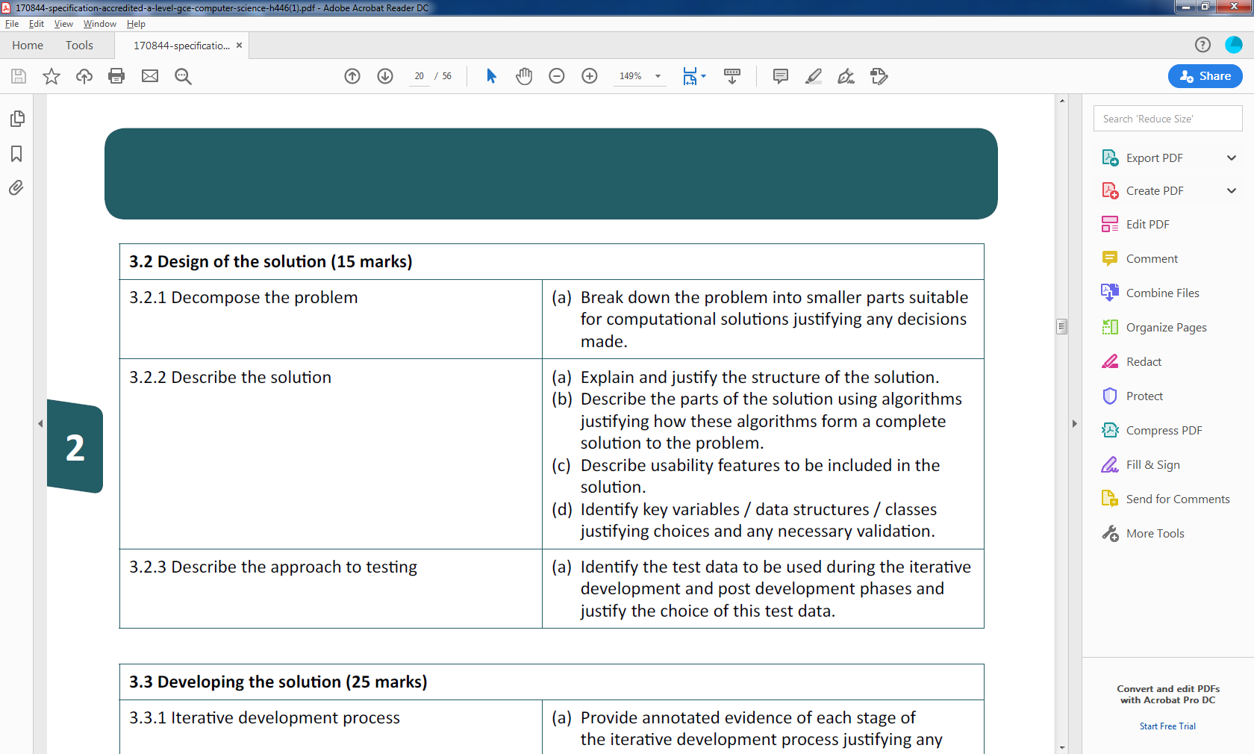
COMPONENTS

Slide 4
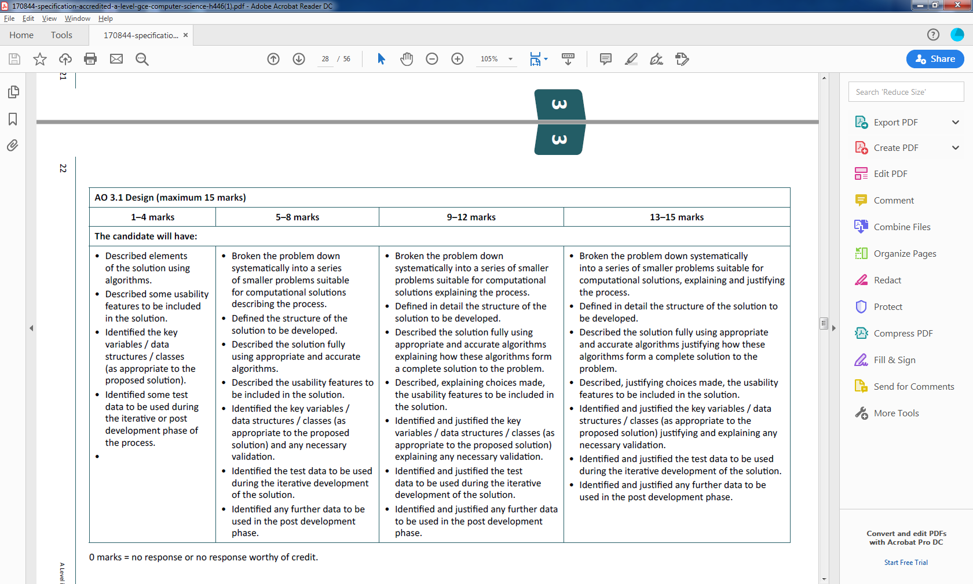
3.2.2 DESCRIBE THE PROBLEM

Slide 5
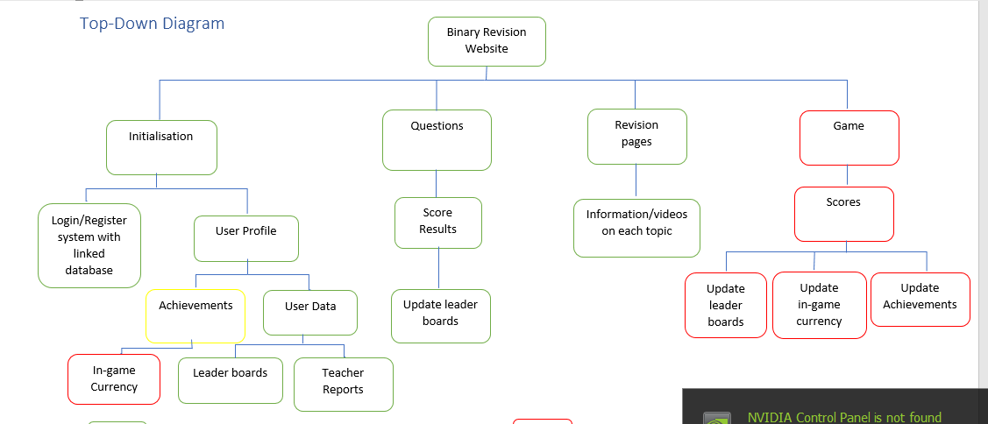
TOP DOWN DESIGN

Slide 6
JUSTIFICATION
WHY USE DECOMPOSITION N THIS WAY:
EG
BINARY REVISION WEBSITE
THIS IS THE OVERALL PRODUCT THAT I WILL BE PRODUCING, WHICH CAN BE BROKEN DOWN INTO MANY SMALLER SUB-PROBLEMS USING DECOMPOSITION. THESE SUB-PROBLEMS CAN THEN BE SOLVED INDIVIDUALLY USING SEPARATE FUNCTIONS FOR MOST OF THEM, THIS MEANS THAT I CANNOT INTERRUPT THE LOGIC OF A SUB-PROBLEM WITH ANOTHER, MEANING THAT IT IS MUCH LESS LIKELY FOR ME TO CAUSE AN ERROR IN A SEPARATE FUNCTION.

Slide 7
JUSTIFICATION
WHAT DOES EACH ALGORITHM DO?
LOGIN/REGISTER SYSTEM
THIS WILL BE AN INDIVIDUAL MODULE SO THAT IT CAN EASILY BE TESTED IN ISOLATION AND NOT AFFECT ANY OTHER AREAS OF THE PROGRAM, THIS WILL ENSURE THAT I CAN IDENTIFY ANY ISSUES WITHIN THE FUNCTION.
THE LOGIN/REGISTERING SYSTEM WILL CONTAIN 2 BUTTONS FOR THE USER TO CLICK ON, EITHER LOGIN OR REGISTER. IF THE USER CLICKS LOGIN, THEN THEY SHALL BE ASKED TO INPUT THEIR USERNAME AND PASSWORD. IF THIS IS CORRECT THEN THAT CAN CONTINUE TO THE REST OF THE WEBSITE WHICH WILL BE CHECKED BY REVIEWING THE DATABASE TO SEE IF THEY MATCH, HOWEVER IF THIS IS INCORRECT AN ERROR SHALL APPEAR AND THEY WILL BE ASKED TO RE-ENTER THEIR DETAILS. IF THEY CLICKED ON REGISTER INSTEAD THEN THEY SHALL BE ASKED TO INPUT THEIR USERNAME, EMAIL, PASSWORD, AND THE PASSWORD AGAIN FOR VALIDATION. IF THE USER INPUTS A TAKEN USERNAME OR EMAIL THEN THEY SHALL BE ASKED TO ENTER A DIFFERENT ONE, THIS WILL BE CHECKED BY SCANNING THE DATABASE TO SEE IF THEY EXIST. ALSO, IF THE PASSWORDS DO NOT MATCH OR IS TOO SHORT, THEY WILL BE ASKED TO ENTER THE PASSWORD AGAIN THAT MEETS THE CRITERIA. ONCE THE USER HAS SUCCESSFULLY LOGGED IN THEY SHALL THEN BE SHOWN TO THE NEXT SECTION, USER PROFILE.

Slide 8
WHAT DOES THIS MEAN?
TAKE EACH PART OF THE TOP DOWN DIAGRAM AND CREATE THE ALGORITHMS USING FLOWCHARTS AND PSEUDOCODE.

Slide 9
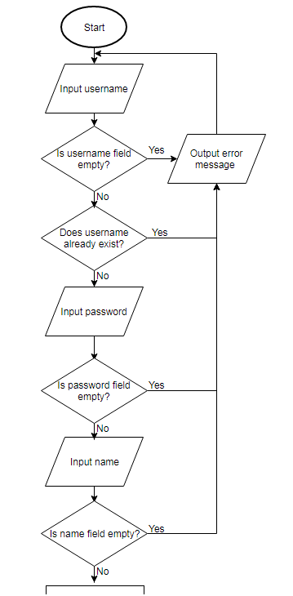
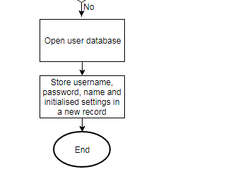
EXAMPLE
CREATING AN ACCOUNT
When the user creates an account they need to enter their name, username and password. An ID needs to be assigned to them and all other fields need to be initialised with a dash, -, symbol.

Slide 10
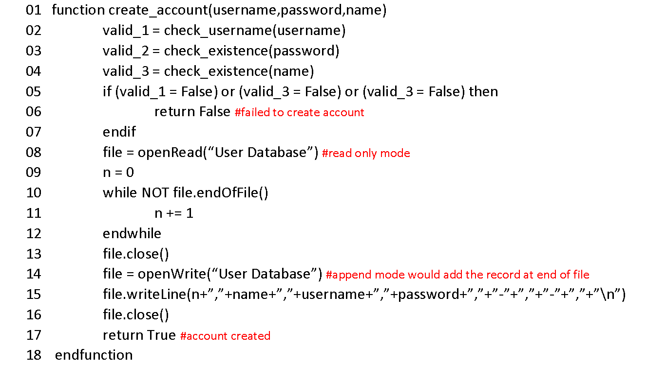
EXAMPLE
CREATING AN ACCOUNT
From the flowchart I then used pseudocode to plan out three functions that will be needed in the process of creating an account.
The function below calls for other functions to check whether the username, password and name are valid. If they are valid then it writes the user’s details into the user database and initialises the other fields. If the username, password or name aren’t valid then it returns False.

Slide 11
3.2.3 DESCRIBE THE APPROACH TO TESTING

Slide 12
WHAT DOES THIS MEAN?
COMPLETE A TRACE TABLE FOR EACH TO TEST THAT THE LOGIC WITHIN THE PSEUDOCODE IS WORKING.
MAKE IT CLEAR WHICH TEST DATA IS BEING USED, EXPECTED OUTPUT AND ACTUAL OUTPUT FOR EACH ALGORITHM.
ALSO MAKE IT CLEAR THAT THIS DATA WILL BE USED THROUGHOUT THE DEVELOPMENTAL STAGES.

Slide 13
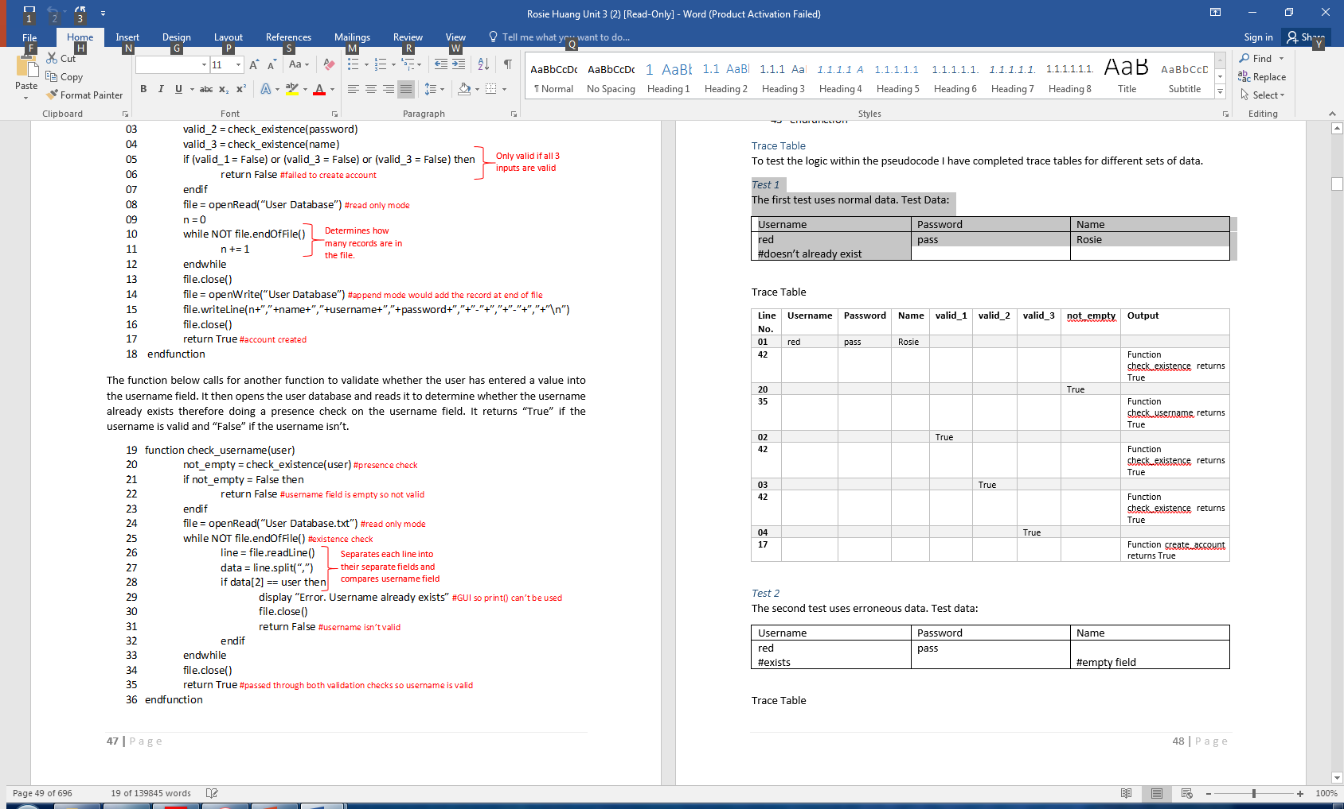
TRACE TABLE

Slide 14
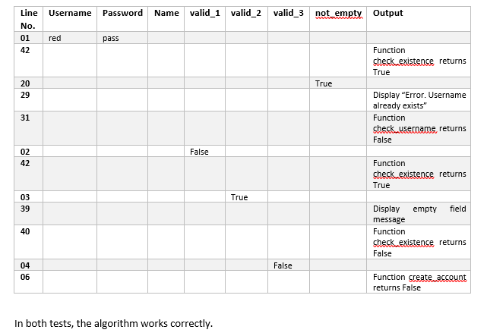
TRACE TABLE

Slide 15
EVIDENCE
ALGORITHMS FOR EACH KEY ASPECT GIVEN IN THE DECOMPOSITION PHASE
EXPLANATION OF WHAT THE ALGORITHM DOES-
  IS IT LINKED TO OTHERS?
ALGORITHM IN THE FORM OF A FLOWCHART AND PSEUDOCODE
TRACE TABLES USING EXPLICIT DATA FOR NORMAL, EXTREME AND ERRONEOUS VALUES

Slide 16
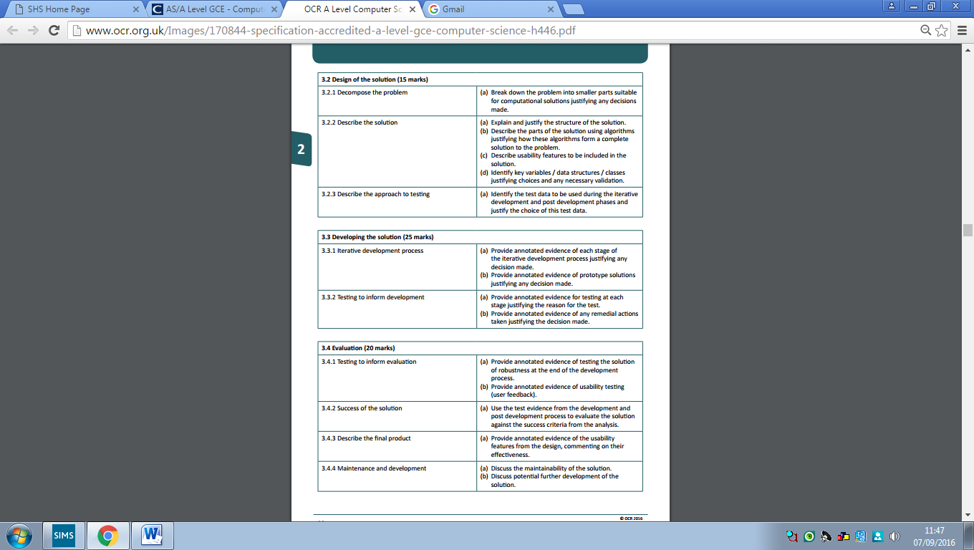
COMPONENTS

Slide 17
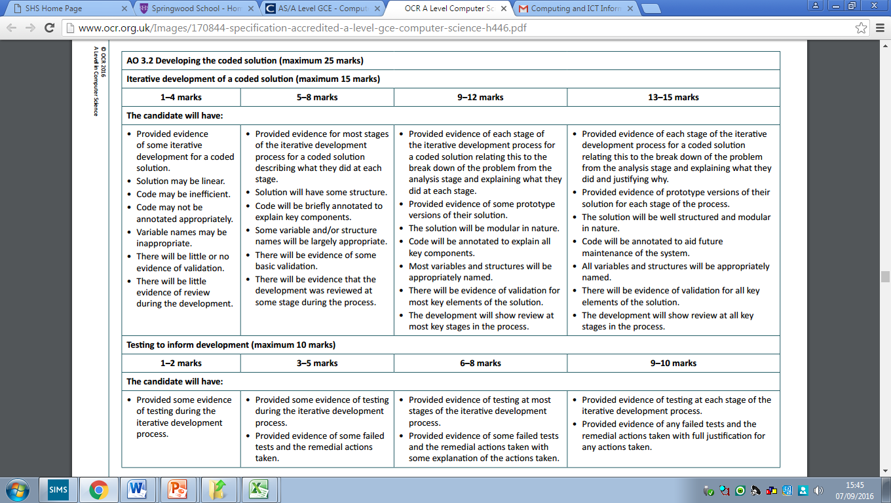
3.3.1 ITERATIVE DEVELOPMENT PROCESS

Slide 18
WHAT DOES THIS MEAN?
FOR EACH ALGORITHM SHOW STEPS INVOLVED IN CODING THE SOLUTION.
  ANY PROBLEMS ENCOUNTERED DOCUMENT CODE EXPLAINING HOW IT WAS DEBUGGED
  PROOF OF IT RUNNING
  RESEARCH CARRIED OUT (WITH SOURCES) ETC
  GIVE ANNOTATED CODE AT EACH STAGE

Slide 19
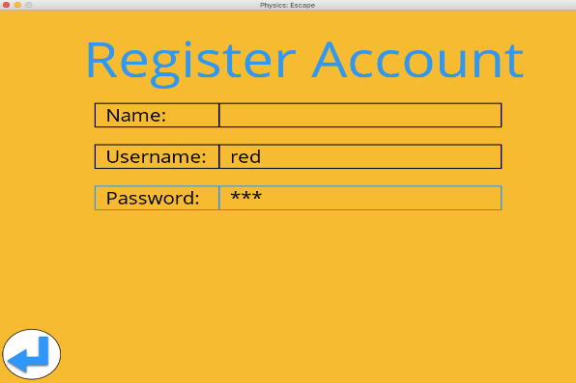
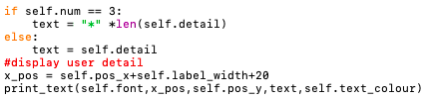
DEVELOPMENT
Further validation will be required for the name as names only contain letters. But this will be done when the user attempts to register an account.
The next aim is to ensure that anything typed in the password field will appear as asterisks. It would require the update(mouse_pos, chosen, text) method to determine whether the field is the password field. I’ve used a local variable text to store what will be displayed. This way the attribute detail is unaffected.

Slide 20
3.3.2 TESTING TO INFORM DEVELOPMENT

Slide 21
WHAT DOES THIS MEAN?
FOR EACH ALGORITHM TESTING OCCURS DURING DEVELOPMENT.
  USE THE TEST DATA AND RESULTS GAINED IN THE TRACE TABLES
  PROOF OF IT RUNNING
  COMMENTS ON SUCCESS AND/OR REMEDIAL ACTIONS REQUIRED
  GIVE ANNOTATED CODE AT EACH STAGE

Slide 22
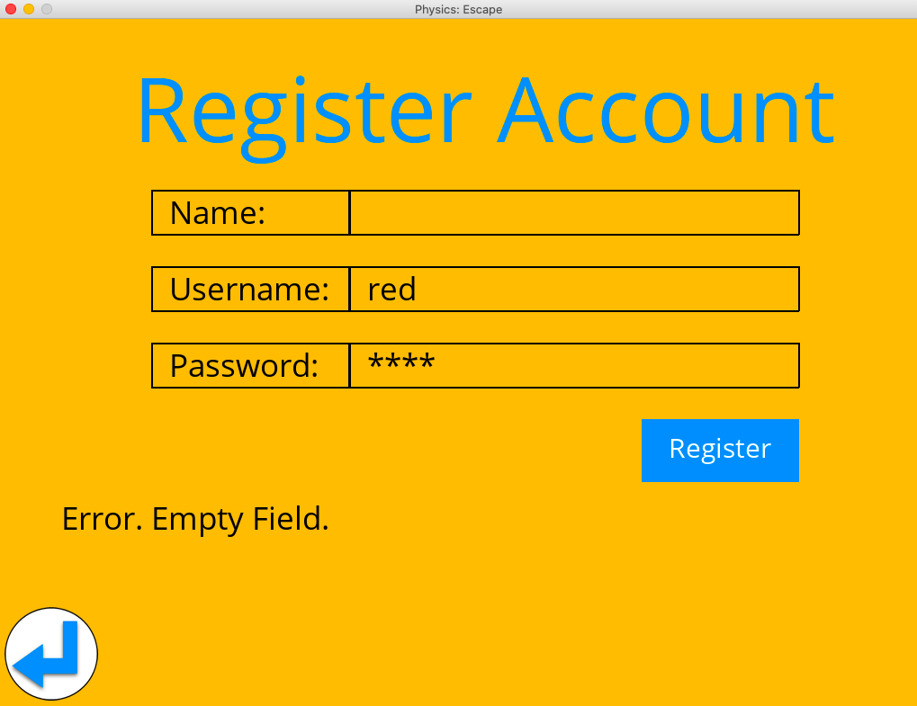
TEST 2:
THE EXPECTED OUTCOME IS THAT THE MESSAGE “ERROR. EMPTY FIELD” IS DISPLAYED.
THIS IS BECAUSE THE PRESENCE CHECK IS THE FIRST VALIDATION THAT OCCURS. ACTUAL OUTCOME:
Username | Password | Name
red #exists | pass | #empty field

Slide 23
GOOD LUCK!
AIM TO GET 1 ALGORITHM DONE AS THIS!!
DON’T CODE AND FORGET TO DOCUMENT THIS SECTION!
CONTACT ME WITH ANY CONCERNS!

Slide 24
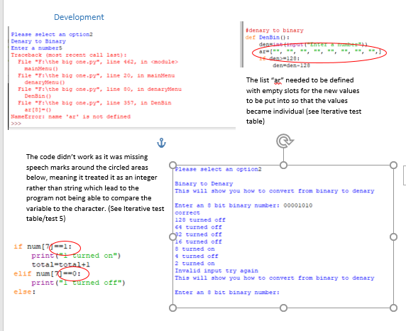

Slide 25
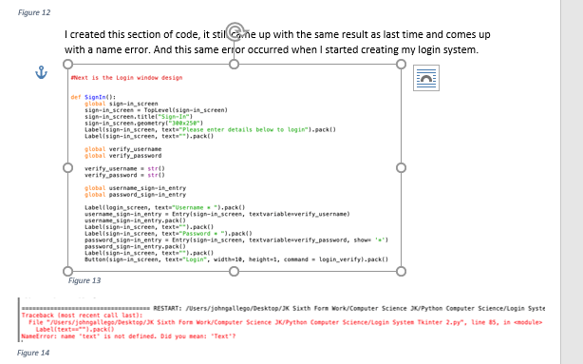

Slide 26
GRADE BOUNDARIES
COURSEWORK
Grade | Score /70
A* | 63
A | 55
B | 47
C | 40
D | 33
E | 26

